Slide 1
ETF Analysis and Forecasting
By: Jeff, Exzavier, Nipun

Slide 2
Overview

Slide 3
Core Message and Hypothesis
Goal: To analyze the performance of ETFs in the Mining (XME), Oil (OIH) and Energy (IYE) sectors to observe is any correlation in price exists.
We also wanted to determine which of the 3 would be the best investment by using Monte Carlo Forecasting to predict future returns.
We chose these ETFs since we hypothesized there would be a high degree of correlation and relatively stable prices.

Slide 4
ETF Analysis

Slide 5
Data Exploration and Cleanup
Import descriptions
Dotenv and Alpaca Keys
Pulling Data and formatting dates
Data types and Nulls
Dropping unnecessary data

Slide 6
Data Analysis
Daily Returns
Dataframe Renaming
Rename ‘Close’ column
These steps done for all 3 tickers
Concat into one Dataframe
HVplots
Cumulative returns
STD calculations, showing trend of volatility
Oil Had highest

Slide 7
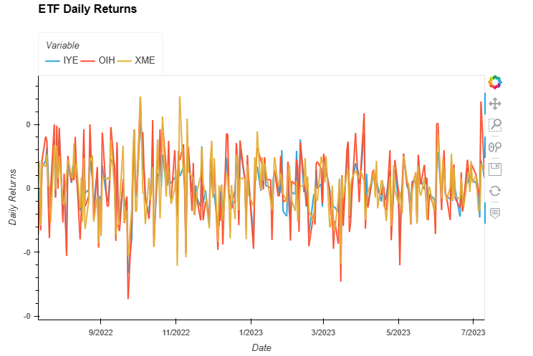
Data Analysis (cont’d)

Slide 8
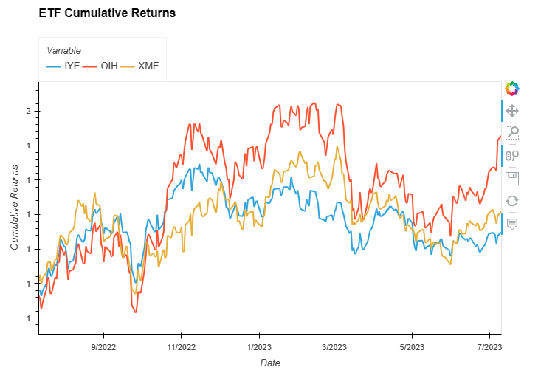
Data Analysis (cont’d)

Slide 9
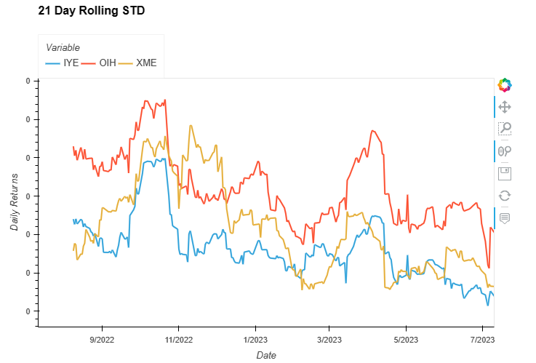
Data Analysis (cont’d)

Slide 10
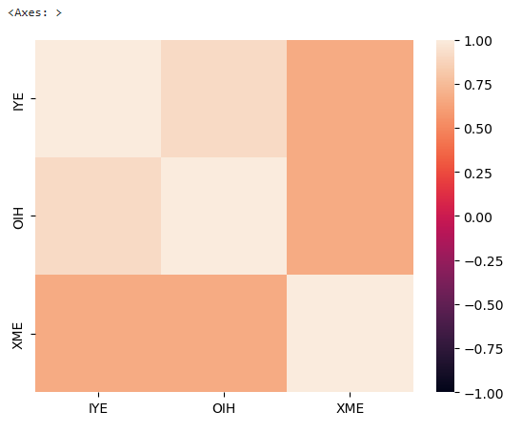
Data Analysis (cont’d)
Correlation
We observed a higher correlation between OIH and IYE as we expected

Slide 11
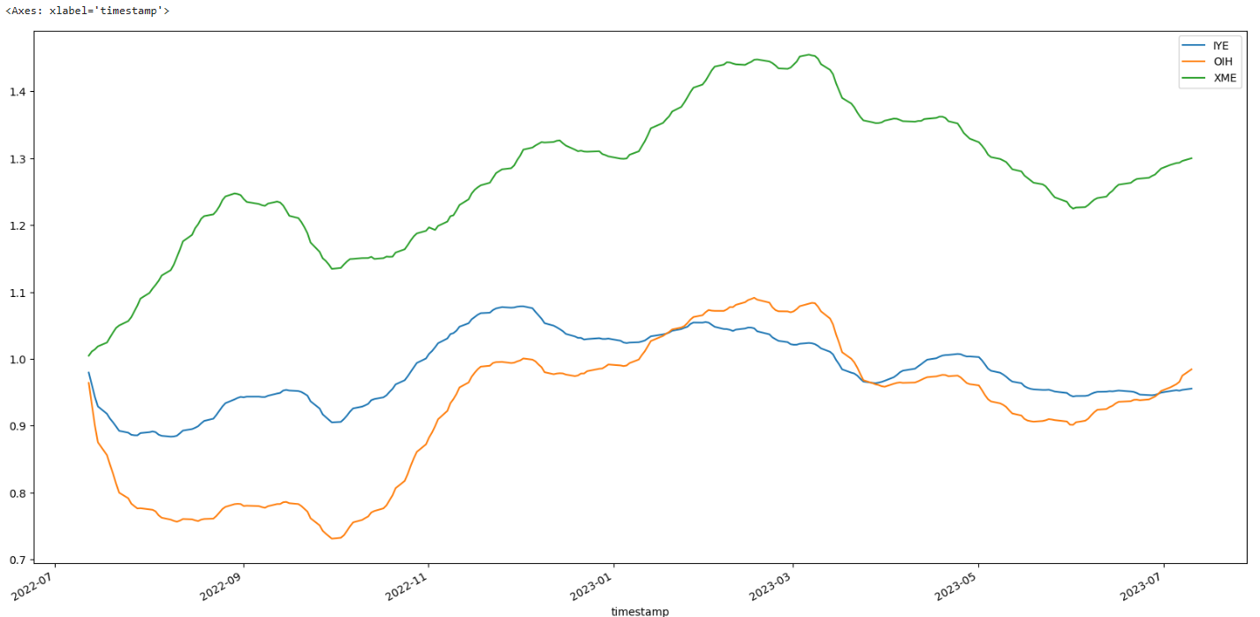
Data Analysis (cont’d)

Slide 12
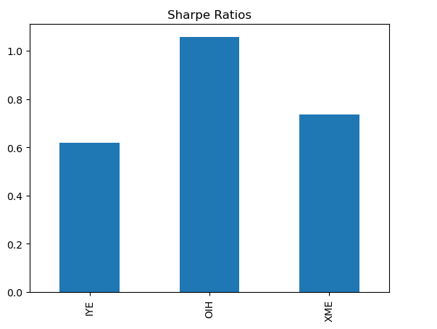
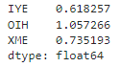
Data Analysis (cont’d)
Annualized Sharpe ratio
OIH had highest
Industry standard rates sharpe ratio of 1 as “acceptable”

Slide 13
Conclusion
What does this data mean?
What correlation is there, if any?
Which ETF is the best investment?
Noticed the mirroring of STDs (volatility) of all 3 ETFs

Slide 14
ETF Forecasting

Slide 15
Data Exploration and Cleanup
Imports and new libraries
Dotenv & Alpaca Keys
Placing data in one dataframe
Number of simulations
Different weights
Span of forecast

Slide 16
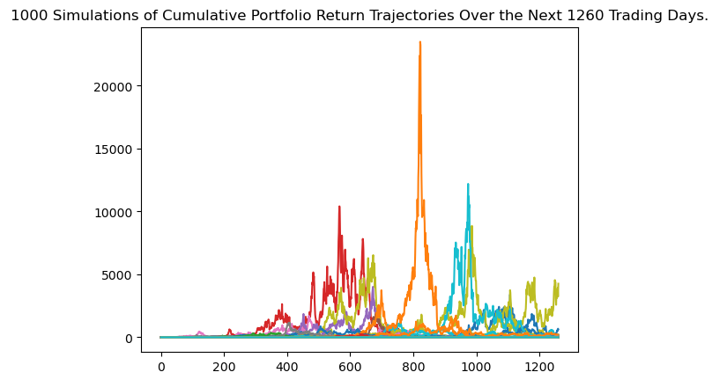
Data Analysis
Line plot of simulations
Note 600 and 1000 day mark
Outlier at ~800 day mark

Slide 17
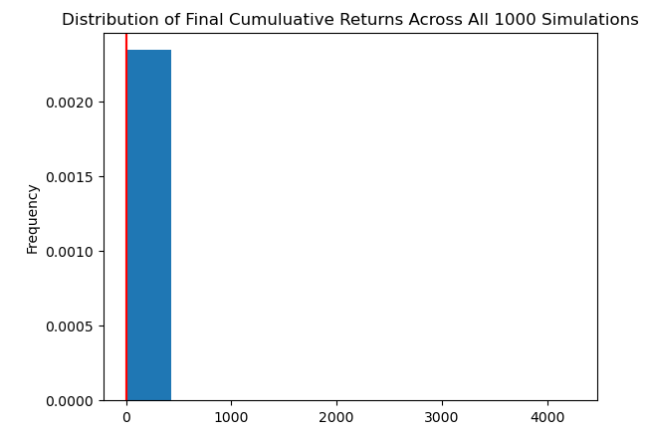
Data Analysis

Slide 18
Conclusions
Confidence intervals
Potential return on a set investment shows high risk
There is a 95% chance that an initial investment of $10,000 in the portfolio over the next 5 years will end within the range of $0 and $17,146.91
We expected high correlation between the 3 ETFs and for them to be a relatively stable investment
We saw that this was not the case
Potential explanations of skewed data?

Slide 19


Thanks!

